Slide 1
RUNGTA COLLEGE OF DENTAL SCIENCES AND RESEARCH
RESIN BONDED BRIDGES
DEPARTMENT OF PROSTHODONTICS
PRESENTED BY RUCHA KASHYAP

Slide 2
CONTENTS
Introduction
Acid etching of enamel
History of Resin Bonded Prosthesis
Review of literature.
Advantages
Disadvantages
Indications
Contraindications

Slide 3
Design concepts
Selection of abutments
Bur selection
Anterior & posterior tooth preparation & framework design
Impression procedure
Lab procedure
Bonding
Cements
Longevity and scope
Summary and conclusion
References

Slide 4
INTRODUCTION………

Slide 5
Conventional procedures for the preparation of abutment teeth often involve major removal of tooth structure. when the abutment is sound, conventional full coverage procedures seem quite radical. Recent innovations in acid-etch technique have led to new alternative to traditional R_{X} for esthetic & restorative procedure.
RRFPD have had variable popularity .
Primary goal of RRFPD is replacement of missing teeth & max conservation of tooth structure.

Slide 6
ACID ETCHING OF ENAMEL
Buonocore (1955)
Large increase in surface area
Exposure of organic frame work
Removal of inert enamel
Absorbed layer of highly polar phosphate groups

Slide 7
SILVERSTONE(1975)
Loss of surface contour
Creation of a porous subsurface layer
Use of acid of strength 30-40%
10 micron loss of surface contour and
20 micron depth of histologic change

Slide 8
TYPES OF ACID ETCHING

Slide 9
HISTORY…..

Slide 10
HISTORY OF RESIN BONDED PROSTHESIS
Bonded Pontics
Cast Perforated Resin Retained FPD’s
Etched Cast Resin Retained FPD’s
Macroscopic Mechanical Retention Resin Retained FPD’s
Cast Mesh FPD’s
Chemical Bonding Resin Retained FPD’s
Fibre Reinforced Composite Resin FPD’s

Slide 11
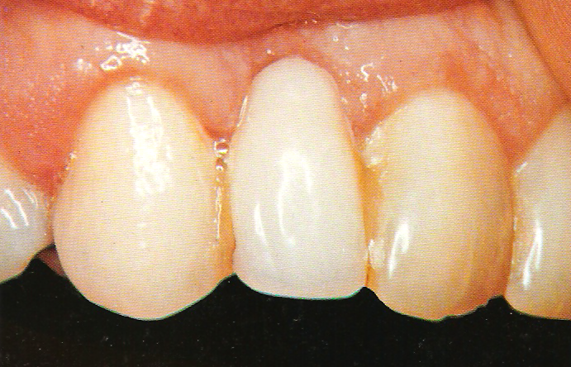
BONDED PONTICS
ACRYLIC RESIN DENTURE TOOTH
IBSEN (1974)
BUONOCORE (1975)
COMPOSITE RESIN CROWNS

Slide 12
NATURAL TOOTH PONTIC
SIMONSEN, DAVILLA AND GWINNET

Slide 13
DISADVANTAGES
Brittle……
Supporting wire…..
Limited to short anterior spans……
Limited lifetime……….
Debonding of resin ………
Subsequent fracture………………

Slide 14
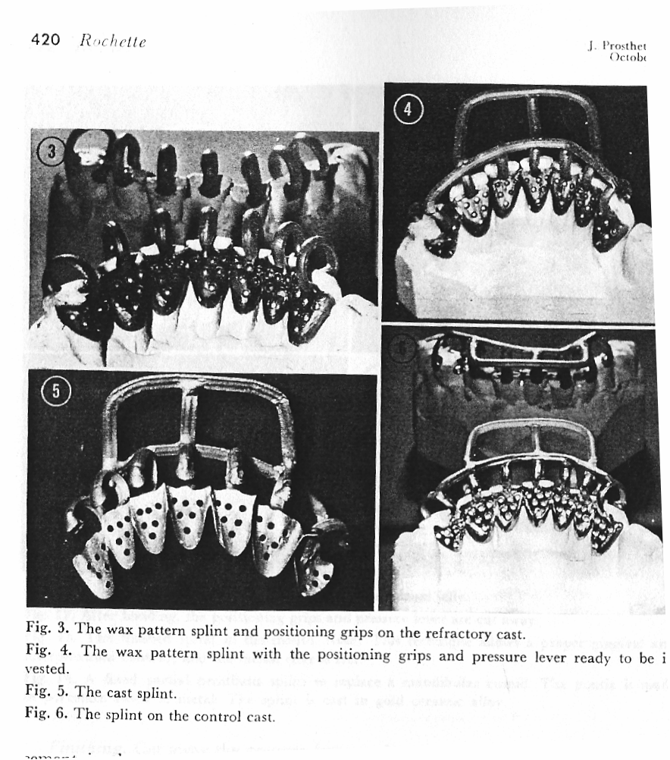
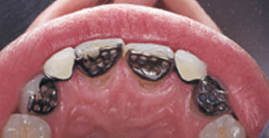
CAST PERFORATED RESIN – RETAINED FPD’S (MECHANICAL RETENTION)
Rochette bridge Allen L. Rochette – A French physician and Dentist

Slide 15
HOWE AND DENEHY (1977)
LIVADITIS

Slide 16
ADVANTAGES
Can see the retentive perforations
Removal is easy by cutting composite resin
No metal etching
DISADVANTAGES
Perforation could weaken the retainer
Exposed resin subjected to external stress, abrasion & marginal leakage
No perforation on proximal rest

Slide 17
ETCHED CAST RESIN – RETAINED FPD’S ( MICROMECHANICAL RETENTION )
Thompson & Livaditis at University of Maryland

Slide 18
ETCHING TECHNIQUES
1. Electrochemical etching
2.Non electrochemical etching

Slide 19
ETCHING APPARATUS
Electrodes: 0.036 inches stainless steel orthodontic wire or a copper wire 12-14 gauge
Electrolytes used vary according to metal type.
Ni-Cr Be alloys : 10% sulphuric acid.
Ni-Cr/Co-Cr : 3.5% nitric acid.
D.C. power supply

Slide 20
ELECTROCHEMICAL ETCHING 2 STEP ETCHING PROCESS
NON Be Ni Cr ALLOY | Be Ni Cr ALLOY
3.5% NITRIC ACID 250mA\cm² ---5min 18% Hcl--- 10 min | 10% H₂SO₄ 300mA\cm² 18% Hcl--- 10 min

Slide 21
ONE STEP ETCHING PROCESS
Proposed by Mclaughlin
Electrolyte and cleaning solution were both combined and placed in the ultra sonic bath.
ADVANTAGES
Time saving – 110 secs
Less equipment required
Etched metal surface was brighter
No difference in bond strength

Slide 22
DRAWBACKS
Technique sensitive
Lab dependent
Varies with metal type
Prone to contamination
Cannot be done with noble metal alloys

Slide 23
NON ELECTROCHEMICAL ETCHING
Livaditis suggested a non electrolytic technique for etching a nickel-chromium beryllium alloy
Placed in an etching solution for one hour in a water bath at 70⁰C
Doukoudakis proposed the use of a stable aqua regia gel
Advantage – no special equipment

Slide 24
zc

Slide 25
SOCKWELL TYPE
Used for addition retention
Both perforations & etching of the framework
Can be used where perforation cant be placed

Slide 26
MACROSCOPIC MECHANICAL RETENTION RESIN – RETAINED FPD’S
Developed by Moon & Hudgins et al
Virginia Common wealth university school of dentistry …….Virginia bridge…..

Slide 27
Lost salt technique
Salt crystal size 150-250 microns
Adequate bond strength
Air abrasion with aluminium oxide
More retentive

Slide 28
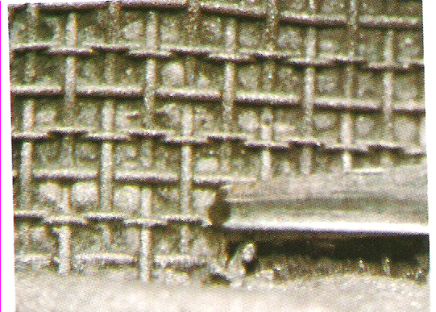
CAST MESH FPD’S
Taleghani
Here the nylon mesh is placed on the tissue surface of the retainer wax pattern

Slide 29
DRAWBACKS
Does not adapt to cast during pattern fabrication
Wax flows between mesh

Slide 30
CHEMICAL BONDING RESIN- RETAINED FPD’S
Adhesive resin cement bond to oxidized or tin plated surface
Resin cements form chemical bond to oxidized surface
Silicoater Classical
Rocatec System
Tin plating

Slide 31
ADHESION BRIDGES
Surface treatment of metals
Sand blasting
Tiller et al (1985)
Used alumina (50 microns) for sand blasting
Concluded sandblasting results in a highly activated metal surface
Demonstrated increased wettability of the surface

Slide 32
SILICOATER CLASSICAL
Tiller et al (1984)
Flame coating of silica carbide for 5 minutes
Silane is coated
Disadvantage – expensive
Uneven distribution of flame
Chemically unstable silica layers
No Protection ,of the layer formed

Slide 33
ROCATEC SYSTEM
Introduced in 1989
Tribochemical application of silica layer by sand blasting
Sand blasting with 110 microns alumina at a pressure of 0.25 Mpa
Sand blasting with 110 microns aluminium oxide modified with silicic acid

Slide 34
TIN PLATING
Done on noble metal alloys
Requires particle abrasion of the alloy surface
Uses a tin amide solution

Slide 35
FIBRE REINFORCED COMPOSITE RESIN FPD’S
Consists of a fiber reinforced substructure
Veneered with composite material
flexural strength , tensile strength & fracture resistance
Translucent

Slide 36
TYPES OF FIBRES
Glass
Polyethylene
Polypropylene
carbon

Slide 37
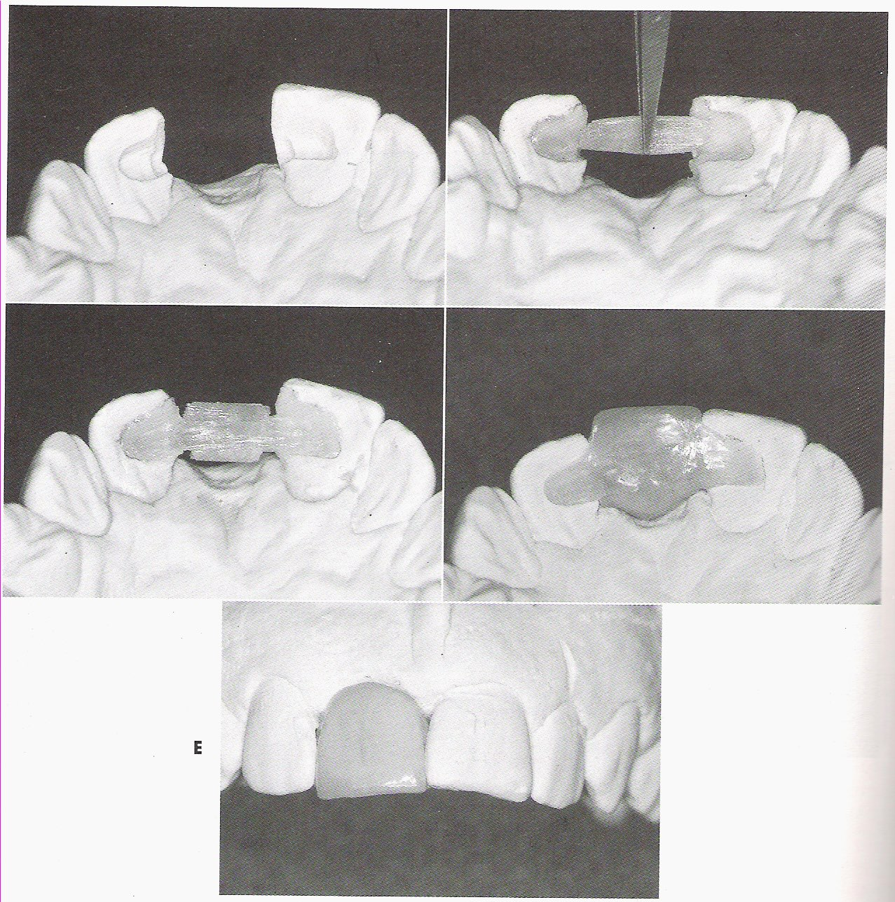
PROCEDURE

Slide 38
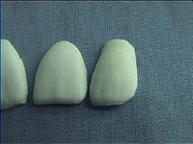
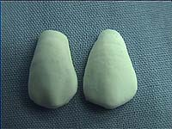
FUNG BRIDGE

Slide 39
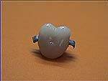
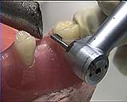
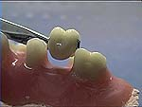
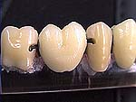
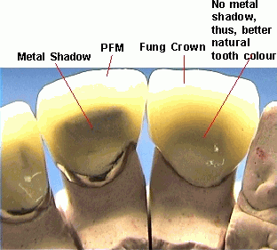
hxh

Slide 40
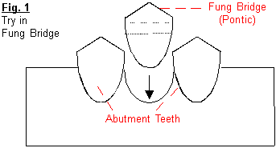
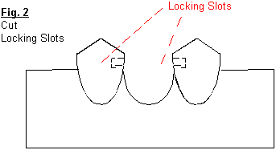
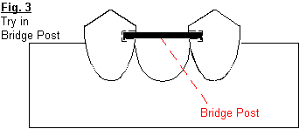
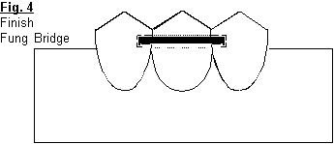
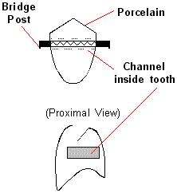
t

Slide 41
ADVANTAGES
It is of lower cost compared to custom made resin – bonded bridges.
Simple to make, not time consuming hardly takes a few minutes.
No need of impression making and laboratory work.
Can be given to patient in a single appointment.
Good esthetics no exposure of metal in proximal areas.
Longevity comparable to resin bonded bridges

Slide 42
REVIEW OF LITERATURE.

Slide 43
Williams V.D, Dremon D.G et al (1982)
studied the effect of retainer design on retention of filled resins to acid - etched FPD’s.
They determined which retainer design had the best retention capacity to enamel.
Rochette used 6 holes with sharp spatula in wax pattern 0.8mm in diameter.
Howe and Denehy used 1-1.5mm, 0.5mm in diameter.
Kuhlke and Drenon used 0.33- 0.5mm thickness holes drilled
Newman bonded orthodontic brackets using fine mesh screen.
They found that all retainer design had enough retention for anterior forces of occlusion. Most retainer failure occurred at retainer - composite resin interface.

Slide 44
G.J. Livaditis and V.P. Thompson (1982))
Described a technique for a retentive mechanism that etches the inner side of the cast fixed partial denture frameworks. They etched metal ceramometal restoration with 0-5N nitric acid was then bonded to the enamel surface utilizing the technique for acid etching enamel. They suggested that improved resin bonded retainers provide innovative conservative and viable alternatives to traditional fixed prosthodontics
Re G.J. et al (1988)
Compared three methods of etching metals for resin bonded bridges. Ni- Cr alloys were air abraded with 50μm alumina MET- ETCH Gel, Electrolytic etching with 10% sulfuric acid for 10 mins at 300mA and Silicoating were evaluated as surface treatments. It was observed that silicoating with electrolytic etching gave superior results. MET- Etch Gel produced lowest shear strength

Slide 45
TANAKA T. ET AL (1986)
studied the effect of oxidation of alloys on the bond strength of resin cements. Here two types of alloys Ni- Cr and Co – Cr alloys were used. Two samples were air brushed with 50μm alumina powder whereas others oxidized with an oxidizing agent. A solution of 0.3% sulfuric acid and 1% potassium per manganate forms an oxide layer thus increasing the adherence of resin cements. It was shown that Ni- Cr alloys developed superior bond strength after sandblasting and oxidation but an equivalent strength was obtained with Co –Cr alloys by merely sandblasting and ultrasonic washing.

Slide 46
ADVANTAGES
Minimum tooth preparation
Lack of pulpal involvement
No anesthesia
Minimum periodontal involvement
Simplified impression procedures
Improved esthetics
Provisional not usually required
Possibility of rebonding
Reduced Cost & chair time

Slide 47
DISADVANTAGES
Irreversible
Uncertain longevity
No space corrections
Good alignment of abutments is required
Plaque accumulation
Esthetics compromised on posterior teeth
Incisal graying
Dependence on laboratory

Slide 48
INDICATIONS
Replacement of missing anterior teeth in children and adolescents
Caries free abutment teeth or unrestored abutments
Maxillary & Mandibular incisor replacement
Periodontal splints
Post orthodontic stabilisation
Prolonged placement of interim prosthesis
Single posterior tooth replacement

Slide 49
CONTRAINDICATIONS
Parafunctional habits
Long edentulous span
Extensive caries
Restored or damaged abutments
Compromised enamel
Nickel sensitivity
Deep vertical overbite
Incisors with thin faciolingual dimensions

Slide 50
SELECTION OF ABUTMENTS
Caries free
Periodontally sound
Adequate thickness of enamel
One abutment on either side

Slide 51
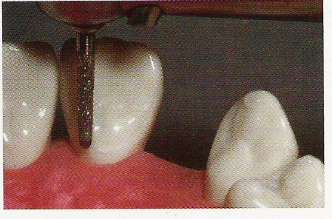
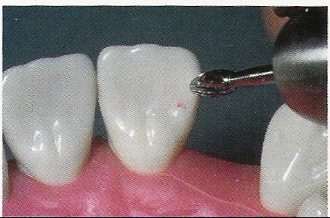
BUR SELECTION
Gingival margins & circumferential preparation –
chamfer tapereddiamond.
Occlusal & incisal rest seats –
diamond / carbide inverted cone burs.
Additional retentive features / slots, grooves or pinholes -- tapered fissure carbide.

Slide 52
ANTERIOR DESIGN PRINCIPLES
Abutment modified ,Proximal wrap around
Extension of framework onto uninvolved marginal ridge
Definite finish line
Cingulum notches or counter sinks
Grooves
Existing restorations may be incorporated

Slide 53
ANTERIOR TOOTH PREPARATION

Slide 54
POSTERIOR DESIGN PRINCIPLES
Distinct path of insertion
Proximal resistance form created
Proximal wrap around obtained
Maximum bonding area utilized
Occlusal rest required
Definite gingival margin

Slide 55
POSTERIOR TOOTH PREPARATION

Slide 56
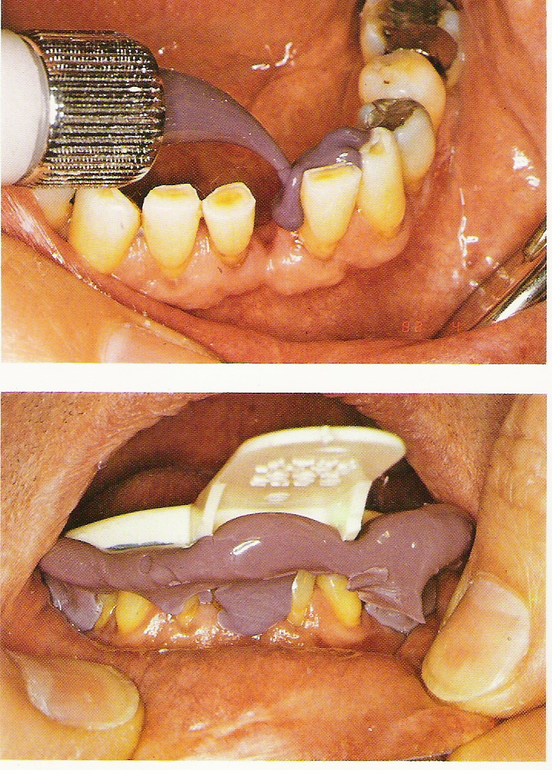
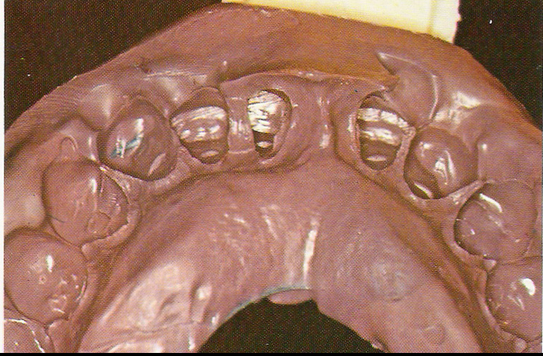
IMPRESSION PROCEDURE
Elastomeric impressions are superior and reversible hydrocolloid is less desirable for final replica.

Slide 57
LAB PROCEDURE
esy

Slide 58
TRY IN
The pontic is evaluated for ridge adaptation, shade, and form, and the occlusion is perfected. The possibility of “greying out” of anterior abutments should be determined and an opaque luting resin selected to effectively mask this phenomenon

Slide 59
BONDING
1. Enamel to Resin bonding
2. Resin to Metal bonding
Mechanical
Micromechanical retention (due to microscopic porosities)
Macromechanical retention (relies on visible undercuts) (usually with a mesh or pitted metal)
Chemical
Chemically active resins
Alloy surface treatments
Tinplating
Silicoating
:

Slide 60
BONDING AGENTS
RESIN CEMENTS
Greater cohesive strength 5000-10,000 psi
Insoluble in oral fluids
Higher film thickness
PANAVIA
C&E META BOND

Slide 61
PANAVIA
Components: Universal and catalyst
Composition : Bisphenol-A-Polyethoxy dimetharyclate,
MDP (10-Methacrloxydecyl dihydrogen phosphate)
77%silanated organic fillers
ED PRIMER - A and B liquids MDP,HEMA & 5NMSA
OXYGUARD II - Polyethylene Glycol
PANAVIA ETCHING AGENT - Phosphoric acid gel

Slide 62
Mixing time : 20-30 sces
Film thickness: 19 microns
Metal surface must be sandblasted or tin coated.
Recent version – PANAVIA F

Slide 63
C&B METABOND
COMPOSITION: Methylmethacrylate polymer powder
Mma liquid modified with 4-META or
4 Methacryloxyethyl Trimellitic Anhydride.
Tri-n-Butyl Borane catalyst.
DISADVANTAGE - poor hydrolytic stability

Slide 64
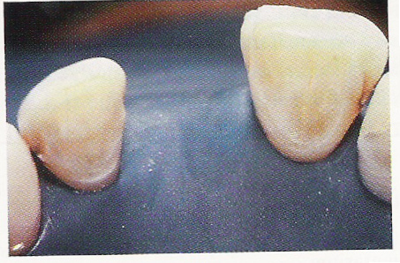
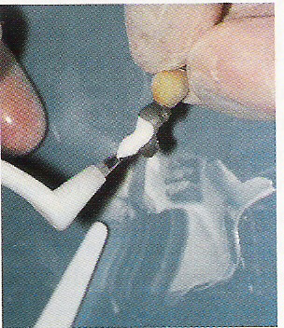
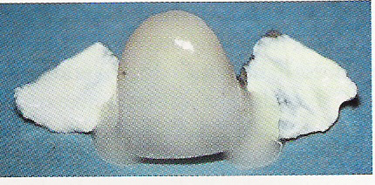
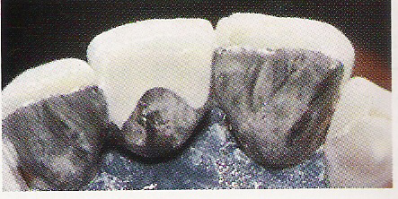
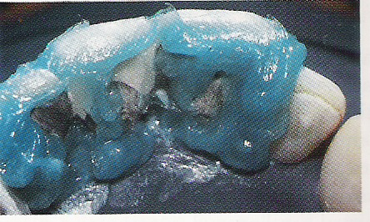
eay

Slide 65
LONGEVITY AND SCOPE
Common reasons for failure include:
poor case selection
inadequate bridge design
inadequate tooth preparation
faulty bonding procedure
occlusal factors.

Slide 66
The most common resin- bonded prosthesis complications are shown below. (Goodacre C.J, Bernad G, et al)
Nature of failure No. of prosthesis studied/affected Mean
incidence
Debonding 7029/1481 21%
Tooth discoloration 343/62 18%
Caries 3426/242 7%
Porcelain fracture 1126/38 3%
Periodontal disease 748/0 0%

Slide 67
POSTOPERATIVE CARE
Regular recall visits
Check for any debonding
Caries
Periodontal health

Slide 68
DISCUSSION

Slide 69
The most popular alternate to this new technique is the complete coverage retainer.
Complete crowns have advantages and indications, and much has been written about their overuse and periodontal disadvantages.
The partial coverage fixed partial denture with inlays, onlays, pin ledges, or three-quarter crowns, are excellent but difficult restorations and require conscientious laboratory support.
A removable partial denture is a viable alternative often selected for economic reasons, or in younger patients for endodontic considerations; but psychologic resistance to a removable restoration is common.
If the etched cast restoration can be maintained intraorally for extended periods of time, it should be considered as an alternative treatment.

Slide 70
SUMMARY
Patient selection
Tooth preparation
Accurate impression
Careful laboratory technique
Use of a good adhesive agent

Slide 71
CONCLUSION
Principles of tooth preparation for FPD is conservation of tooth structure. This is the advantage of RRFPD. Precision and attention to detail are just as important in RRFPD as they are in conventional prostheses.
To provide a long-lasting prosthesis, the practitioner must plan and fabricate a RR restoration with the same diligence used for conventional restorations. The techniques can be very rewarding but must be approached carefully.

Slide 72
REFERENCES
Caughman W.F et al. A double mix cementation for improved esthetics of RBP.
J Prosthet Dent. 1987; 58, 48.
Doukoudakis A et al. A new chemical method for etching metal frameworks of acid etched prosthesis.
J Prosthet Dent 1987; 58, 421.
Gerald McLaughlin. Direct Bonded Retainers. J.B. Lippincott Company 1986.
Goodacre C.J, Bernad G, et al. Clinical complications in Fixed Prosthodontics.
J. Prosthet Dent. 2003; 90, 31-41.
Kern M, Thompson V.P. Bonding to glass infiltrate alumina ceramics adhesive methods and their durability.
J Prosthet Dent 1995; 73, 240

Slide 73
Livaditis G.A. Chemical etching system for creating micromechanical retention in resin- bonded retainers. J Prosthet Dent 1987; 56, 181.
Malone W.F.P, Roth D.I. Tylman’s Theory and Practice of fixed Prosthodontics. VIII Edition, AIPD publications, page 219.
Richard Simonsen, Van Thompson, Gerald Barrack. Etched cast restorations: Clinical and Laboratory Techniques. Quintessence Publication 1983.
Rosenstiel, Land, Fujimoto. Contemperory Fixed Prosthodontics, III edition, Mosby Company, 2001, page 673.
Salam Sakal M.A et al. Effect of tooth preparation design on bond strengths of RBP.J Prosthet Dent 1997; 77, 243.

Slide 74
Shillinburg T. Fundamentals of Fixed Prosthodontics, II edition, Quintessence publication, 2001, page 565.
Wood M et al. Resin Bonded FPD’s II- Clinical findings related to prosthodontic characteristic after approximately 10 years. J Prosthet Dent. 1996; 76, 368.

Slide 75
THANK YOU
THNK YOU

